Slide 1
CUSTOMERBEHAVIOR ANALYSIS
Aishwarya Puranik
Purva Sushil Firodia
Renita Blessina Sathiaraj

Slide 2
About the project
Analyze customer behavior and preferences in the food delivery industry.
Understand customer behavior in the food delivery industry.
Identify and analyze different customer segments
Provide actionable recommendations for the food delivery service.
Predict if the customer is going to continue the business.

Slide 3
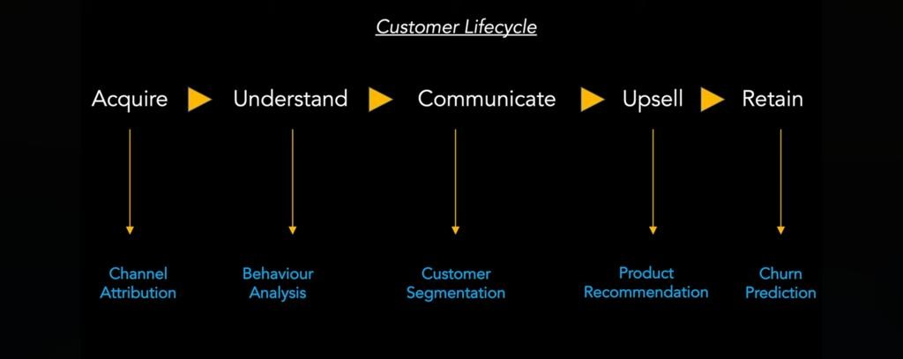
Customer Lifecycle

Slide 4
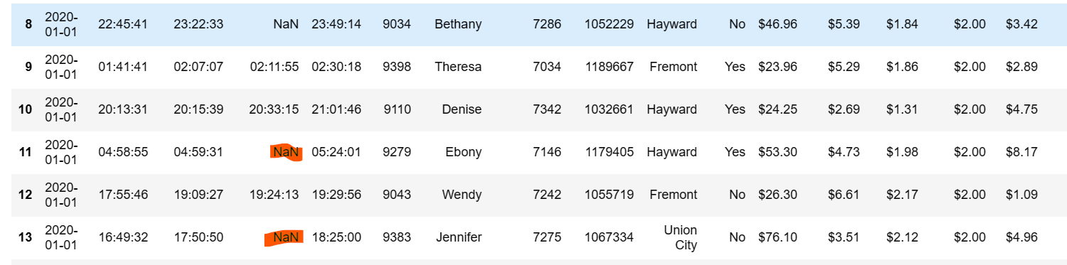
About Dataset
Dataset
The food delivery dataset captures transactions over a specified period, offering insights into customer behavior.

Slide 5
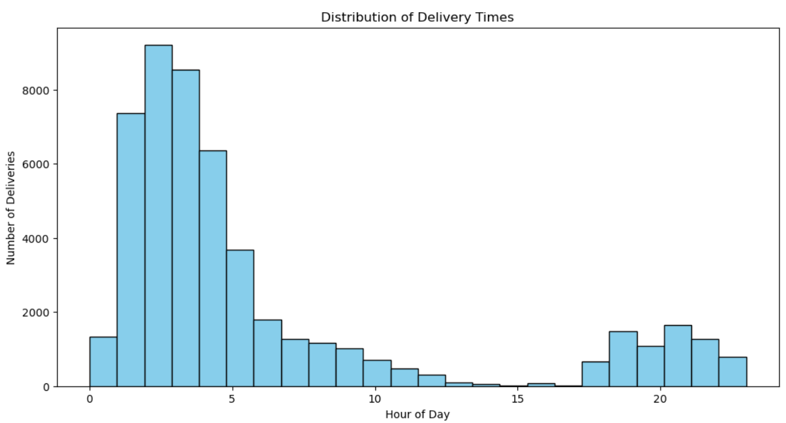
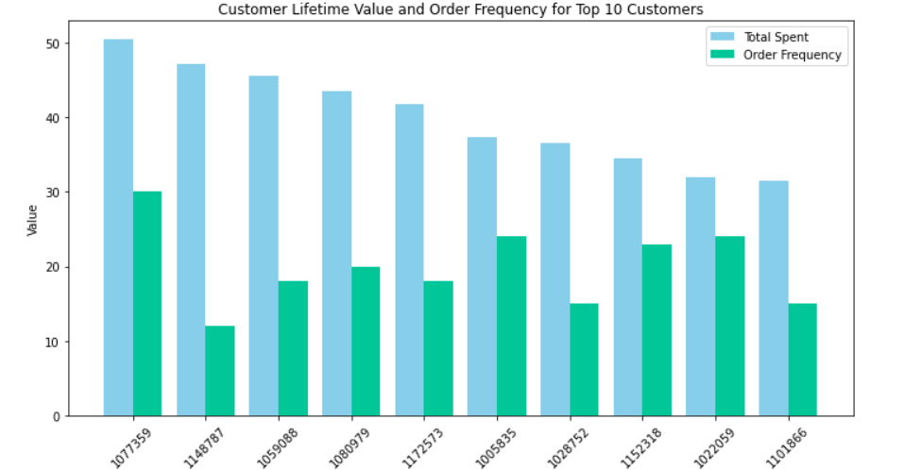
Analysing Customer Behaviour

Slide 6
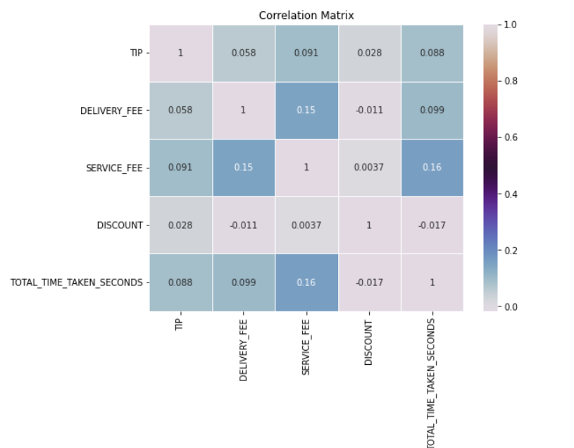
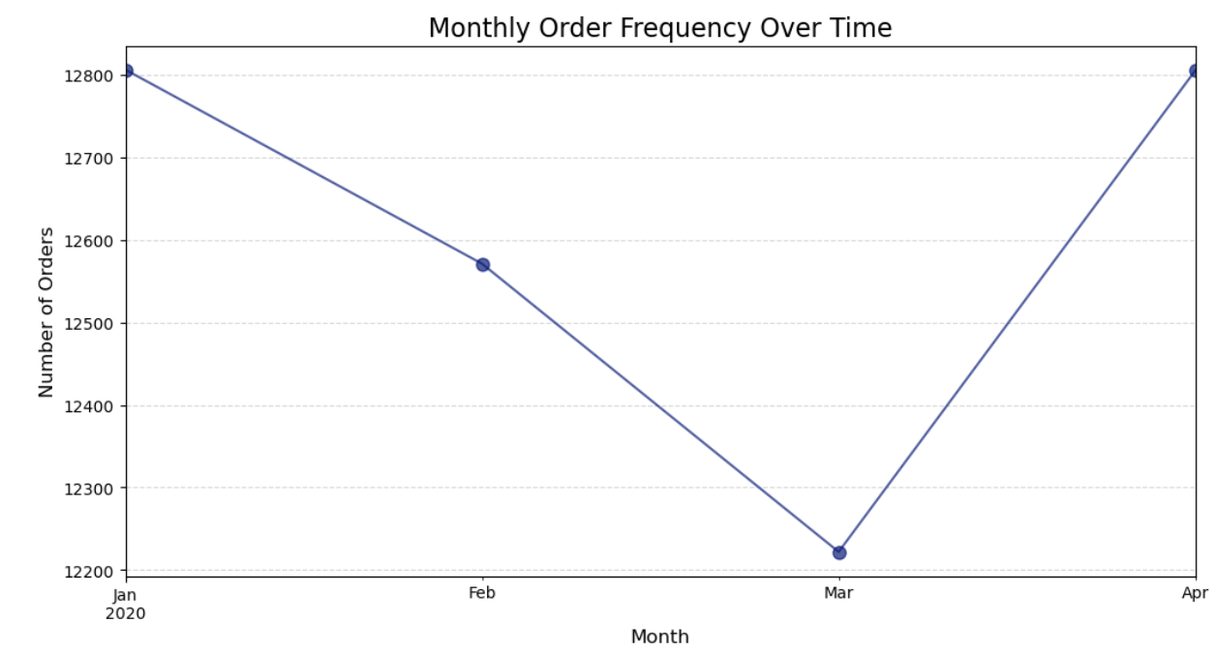
Analysing Customer Behaviour
Notes:
Moving forward with the visualisations the next one is the the correlation matrix. We performed this to explore correlations between different features, such as delivery time and tip amount and understand how various factors influence each other. But there is no strong correlation between any of the features.
The next graph is to analyse the frequency of orders month wise and from the graph it is evident that there are more orders placed during the month of january and April

Slide 7
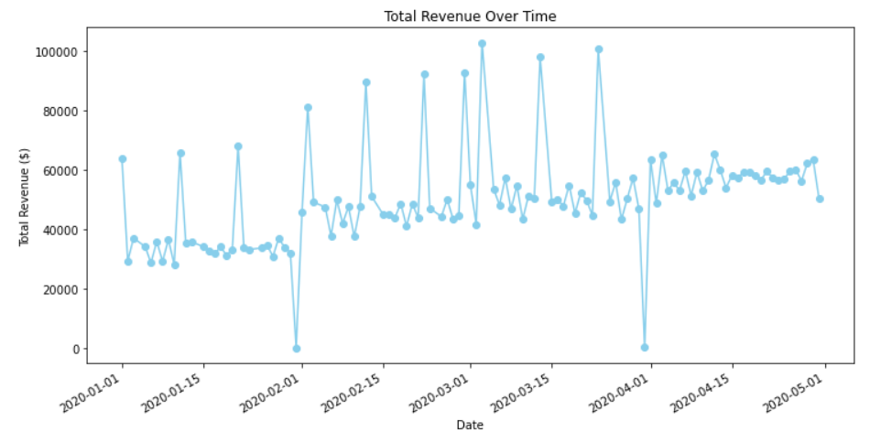
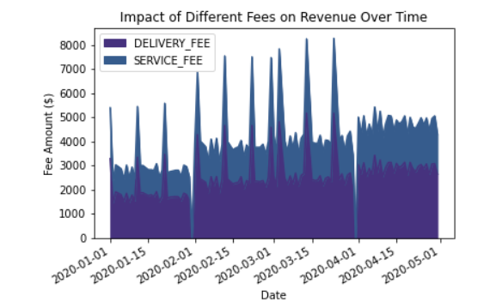
Analysing Customer Behaviour
Notes:
This is the Revenue Analysis:
• Calculate total revenue generated by the delivery service during specific time periods and to Evaluate the impact of different fees on overall revenue and we can see that the service fee had more contribution towards the revenue delivery fee

Slide 8
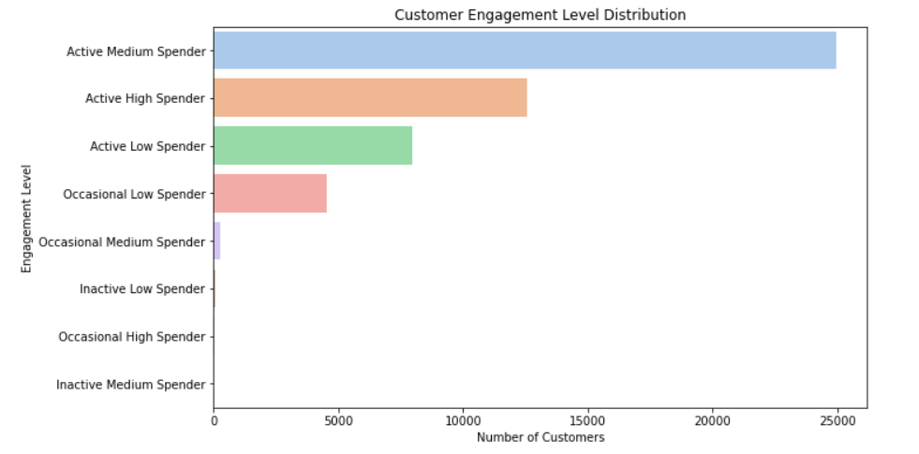
Customer Segmentation
Active High Spender: Exclusive Membership VIP Events
Active Medium Spender: Loyalty Rewards VIP Services
Active Low Spender: Promotional Bundles
Occasional Low Spender: Reactivation Campaigns
Occasional Medium Spender: Upselling Opportunities
Occasional High Spender: Loyalty Recognition Personalized Discounts
Inactive Low Spender: Feedback Surveys
Notes:
Talking about customer segmentation we performed clustering using k means alg and used elbow method to identify the number of clusters and Tailored strategies for each customer segment to enhance service and satisfaction.
The first segmentation is based on engagement levels and most of our customers are Active medium customers followed by Active high spenders, active low spenders and occasional low spenders and the rest are very few which are negligible. These are some strategies to adopt as per our results:
Occasional Medium Spender: Promotional Events: Run occasional promotions and exclusive deals. Upselling Opportunities: Suggest complementary items during orders.
Inactive Low Spender: Reactivation Incentives: Target inactive users with special incentives. Feedback Surveys: Gather feedback to improve services.
Occasional High Spender: Loyalty Recognition: Reward occasional high spenders with loyalty perks. Personalized Discounts: Offer personalized discounts on preferred items.

Slide 9
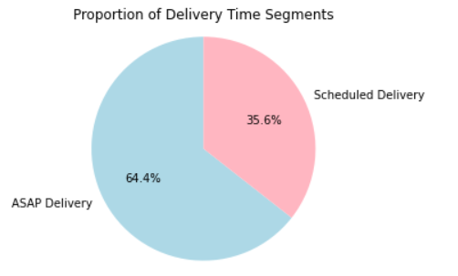
Customer Segmentation
ASAP Delivery Segment:
Promotions for Quick Delivery
Real-Time Updates
Instant Gratification Deals
Scheduled Delivery Segment:
Flexible Scheduling
Subscription Services
Advanced Notifications
Notes:
The next segmentation is based on Delivery times
For customers who prefer ASAP Delivery we can provide some Instant Gratification Deals like Creating special offers or deals that are available only for ASAP deliveries to encourage more frequent and immediate purchases.
For customers who prefer Scheduled Delivery we can Offer subscription or membership services with scheduled deliveries. This can be particularly attractive to customers who prefer routine and planning

Slide 10
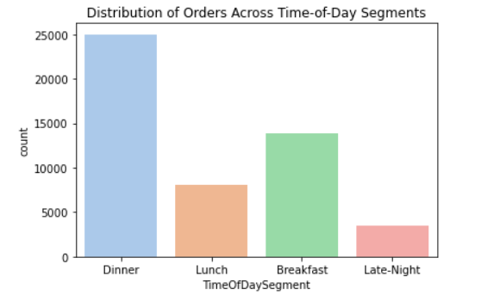
Customer Segmentation
Breakfast (Cluster 0):
Offer morning promotions.
Highlight quick delivery options.
Lunch (Cluster 1):
Introduce value-for-money lunch deals.
Consider corporate packages for office lunch orders.
Dinner (Cluster 2):
Offer family-sized meal deals for dinner.
Encourage group orders.
Late-Night (Cluster 3):
Highlight comfort food options for those winding down in the evening.
Create promotions for popular midnight snacks and quick bites.
Notes:
The last segmentation we performed was depending upon the time of the day customers order
For Breakfast Segment customers we can optimize operations for faster service during breakfast, as customers might be in a hurry and also Highlight healthy breakfast options to appeal to health-conscious customers.
For Lunch Segment we can Introduce lunch specials or combo deals to encourage customers to choose your restaurant for their midday meals and Consider offering packages suitable for business lunches, such as quick-service options or pre-set menus.
For Dinner Segment Ambiance and Experience we Focus on creating a pleasant dining atmosphere for dinner customers. Consider factors like lighting, music, and overall ambiance and Introduce special dinner menu items or chef's specials to attract customers looking for a unique dining experience.
For Late-Night Segment If feasible, we can consider extending operating hours to cater to the late-night crowd and Offer promotions or discounts during late-night hours to attract customers after traditional dinner hours.

Slide 11

Churn Prediction
Feature Engineering: Recency, Frequency, Total Spending
Model Building: Random Forest
Model Evaluation: accuracy, confusion matrix, precision, recall
Notes:
Now the next part of our customer lifecycle is Customer retention. For this we are going to use the technique of Churn Prediction. Churn prediction is the process of identifying customers who are likely to cancel their subscription or close their account.
Here we use machine learning algo to make the prediction. For this the typican process that is followed is
1.Feature engineering:
· It is the technique of transforming data into features that are most useful and can be used to improve the performance of machine learning models.
· We are using features like recency, order frequency and total spending.
· The rationale behind using these features is pretty obvious:
· Recency is a key indicator of customer engagement and the frequency of purchases is a strong indicator of customer loyalty.
· Whereas, High spending customers are valuable for a business. Sudden drops in total spending may suggest a change in customer behavior and potential churn.
· We created the recency by subtracting the order date from today’s date or the most recent date as per our data.
· We created frequency by taking the count of the orders and grouping it by customer ID
· And we created column total spending by adding the amount spent by customer and grouping it by customer ID.
Model building:
· Here we had the options to use different algorithms like Decision tree, SVC, KNN and random forest.
· We tried all of them and finally chose the random forest model as:
· It gave us the highest accuracy.
· Random Forest is an ensemble learning method that combines the predictions of multiple decision trees.
· So, it is more accurate and robust compare to individual model.
· Also, it captures complex non-linear relationships since the churn prediction problems often involved intricate dependencies so random forest was effective.
· Additionally, churn prediction suffers the problem of imbalance data since usually the number pf customers who churn out is usually smaller than those who don’t. Random forest handles imbalance data well when paired with techniques like under sampling or oversampling.
· Random Forests inherently provide a measure of feature importance based on how much each feature contributes to the overall performance of the model. This helped us in dealing with overfitting.
Model building is a iterative process.
Model Evaluation:
· Coming to the most important step that is model evaluation.
· Here we used the parameters like, accuracy, confusion matrix and precision to evaluate our model.
· And these are the results of our model where you can see.

Slide 12
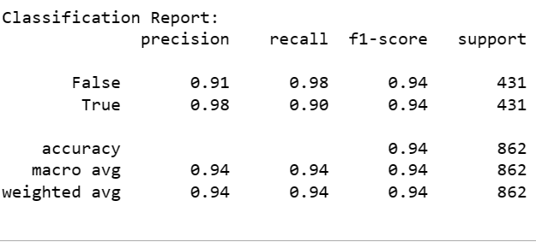
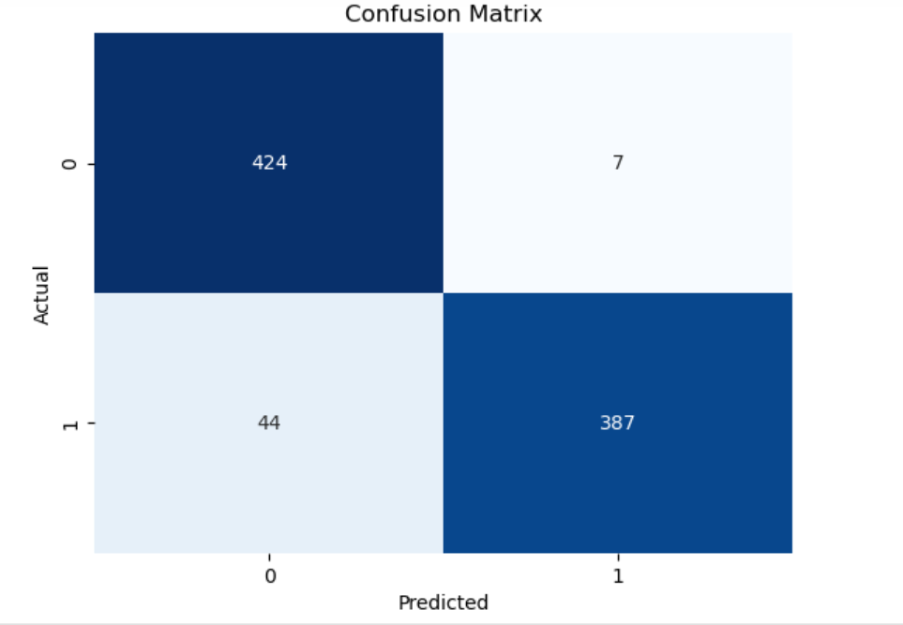
Classification Report
Accuracy: 0.94

Slide 13
Challenges Faced
Data Collection
Data Quality
Imbalanced Model
Model Overfitting
Notes:
Challenges:
· Last but not least there are the challenges that we faced in our project, specially while building the model.
· First is data collection (what type of data to use).
· Second was the data quality cause we had many null values and wrong datatypes, we also removed the unnecessary characters using regex function.
· Now while building the model the challenge we faced was class imbalance which we overcame using technique of under sampling.
· The final one is model overfitting when we tried to use different model. We overcame this Recursive Feature Elimination Used the measure feature importance provided by Random forest

Slide 14
References
https://ieeexplore.ieee.org/document/10248502
https://ieeexplore.ieee.org/document/9720378
https://machinelearningmastery.com/

Slide 15
Thank You!
Customer analysis: See what your customers are really saying.

